Slide 1
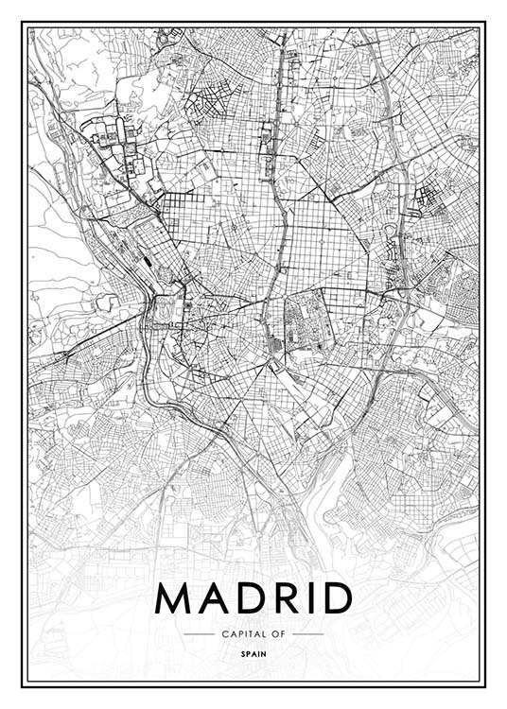
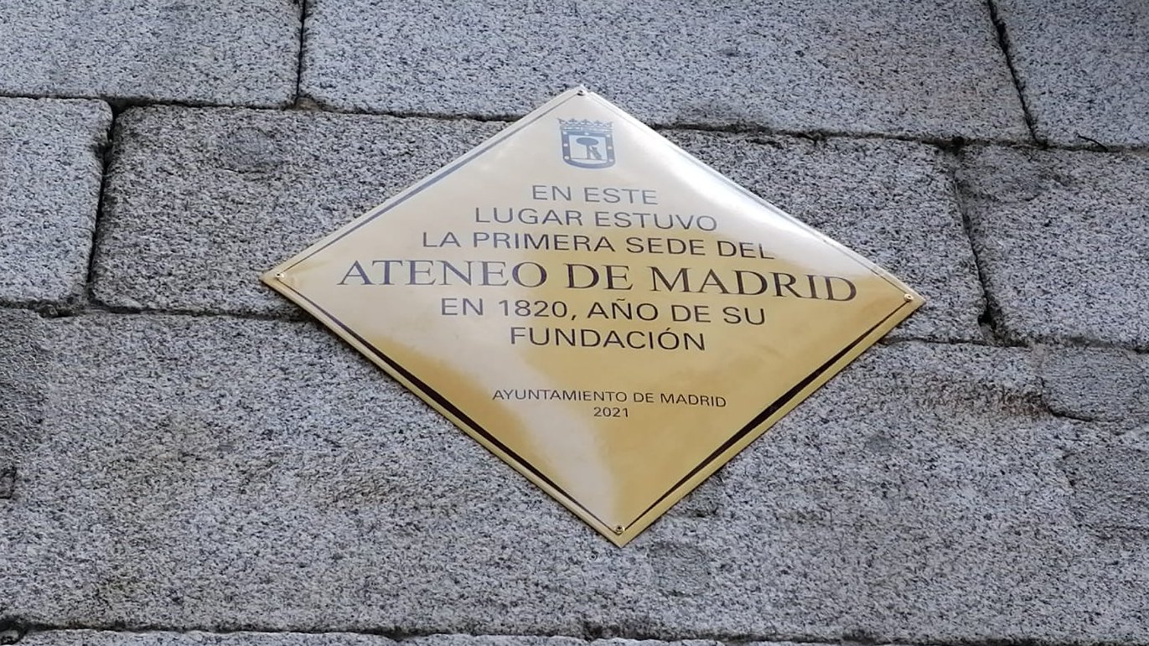

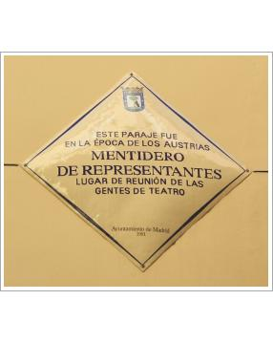
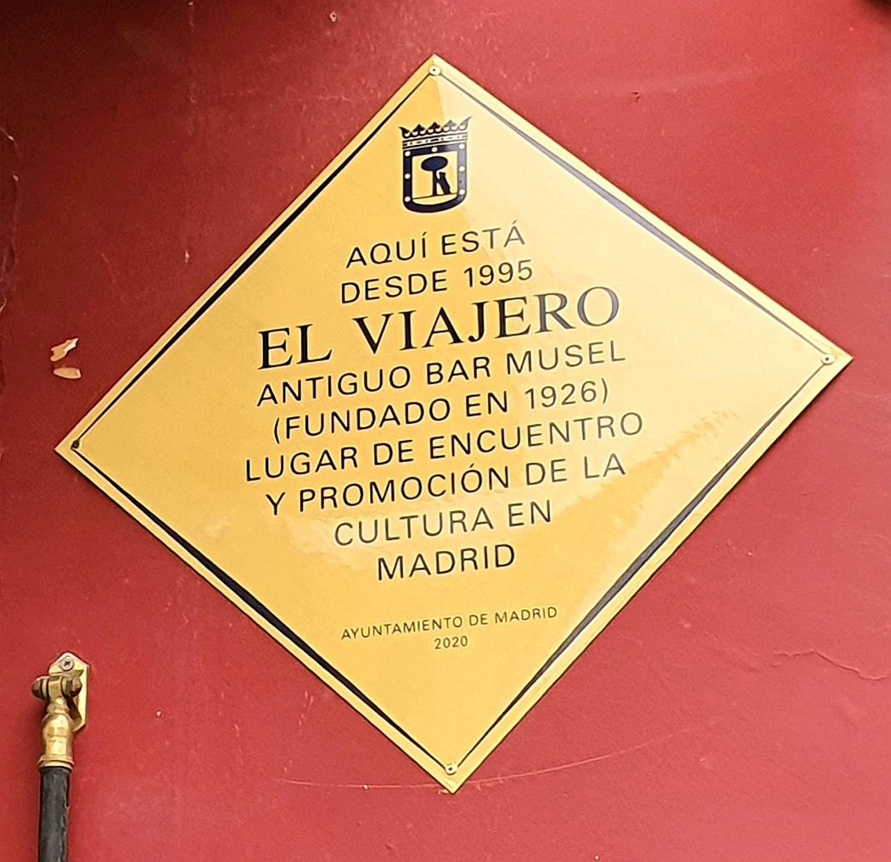
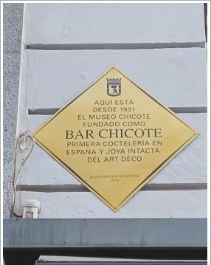
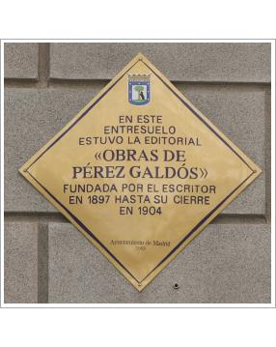
Commemorative plaques of madrid
Carlos Miguel
Manuel Leira
Laura Artiles
Daniel Lorente

Slide 2
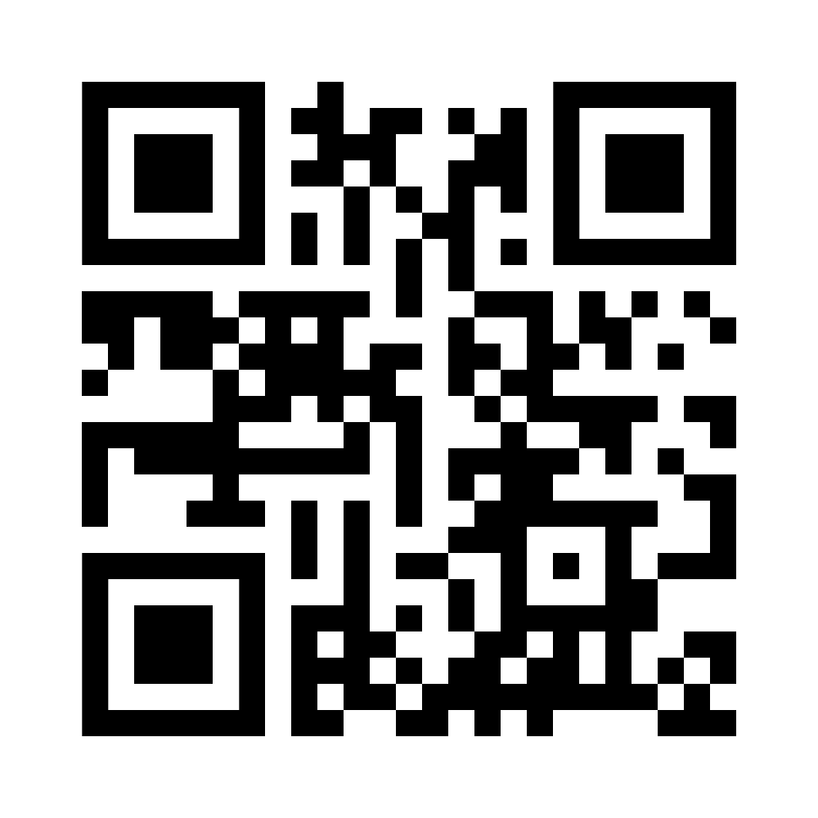


INTRODUCTION TO OUR DATASET
What is our dataset about?
Scan to access the dataset
Data of commemorative plaques in multiple building facades in Madrid.
Events, relevant people and buildings with historical value.
More than 380 plaques
Source of the dataset
Madrid city council → memoriademadrid Digital Library
Licensing of the Data Source
CREATIVE COMMONS - Attribution-NonCommercial 2.5 Spain.
Allows the reuse of the documents and data for non-commercial purposes
Publisher: memoriademadrid Digital Library (Madrid city council)
Righstholder: memoriademadrid Digital Library
Commemorative Plaques of Madrid
Notes:
Portal dedicated to promoting access to municipal government data and fostering the development of creative tools to attract and serve citizens.
License
Allow the reuse of the documents and data subject to them for non-commercial purposes. Reuse is understood as the use of documents by natural or legal persons, for non-commercial purposes, provided that such use does not constitute a public administrative activity.
Authorized reuse includes activities such as copying, dissemination, modification, adaptation, extraction, rearrangement and combination of information.
It is forbidden to distort the meaning of the information. The source of the documents subject to reuse must be cited
The date of the last update of the documents subject to reuse must be mentioned
Metadata on the date of update and applicable reuse conditions must be retained
expressly prohibited to re-identify individuals from the anonymized personal data

Slide 3
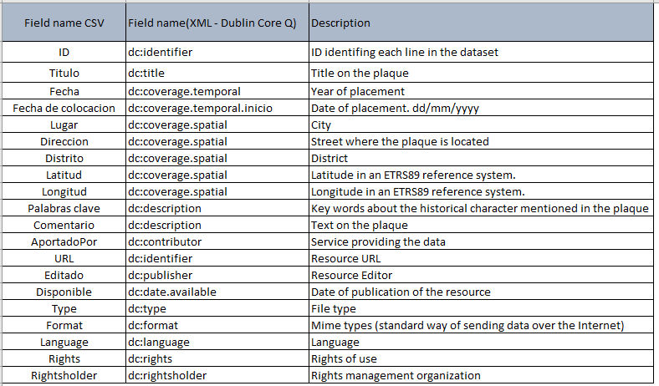
Fields and schema
Notes:
Identifier; title; date; city; address; district; latitud; longitud;
key words; description; contributor; url; publisher;
availability date; type; format; language; rights; righstholder

Slide 4
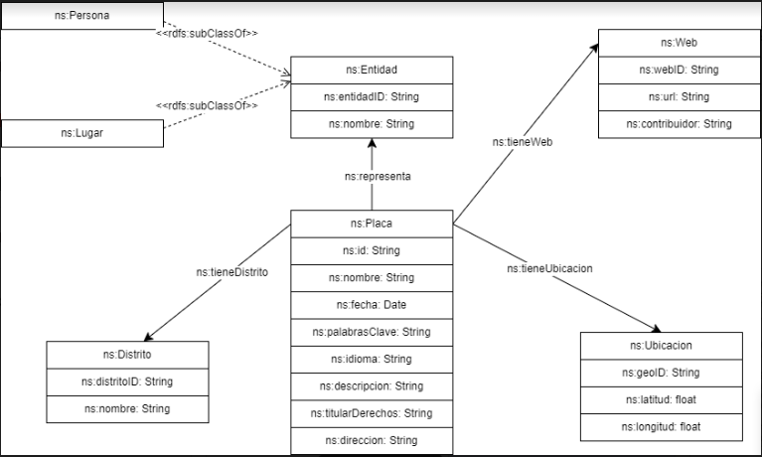
Ontology

Slide 5
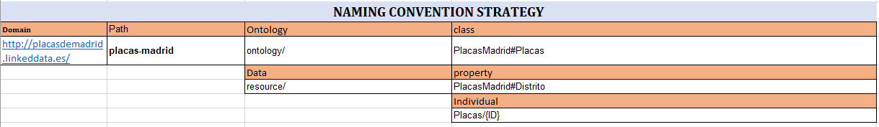
Analisys Of our dataset
Naming Strategy
Dataset Cleaning
Commemorative Plaques of Madrid

Slide 6

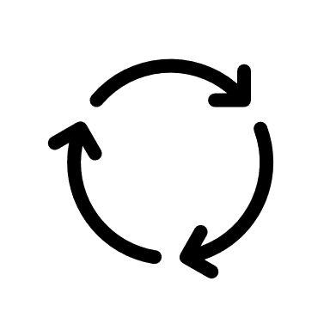


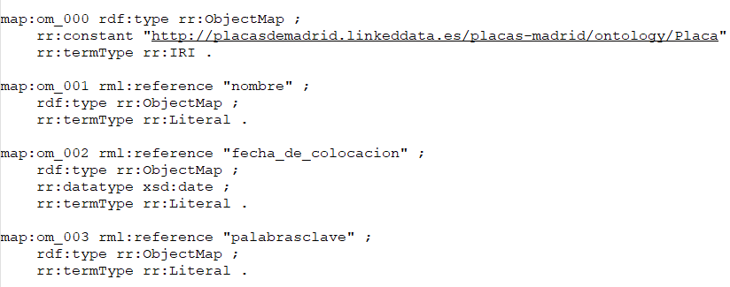
RDF GENERATION
Transformation of CSV data into RDF using YML and RML mappings
YARRRML File
prefixes: …
ns: http://placasdemadrid.linkeddata.es/placas-madrid/ontology/
mappings:
triplesmap1:
sources: - [/content/sample_data/Placas-memoriademadrid-updated.csv~csv]
s: http://placasdemadrid.linkeddata.es/placas-madrid/resource/Placa/$(ID)
po:
- [a, ns:Placa]
- [ns:nombre,$(nombre)]
- [ns:fecha,$(fecha_de_colocacion),xsd:date]
…
triplesmap2: → s: http://placasdemadrid.linkeddata.es/placas-madrid/resource/Distrito/$(distritoID)
triplesmap3: → s: http://placasdemadrid.linkeddata.es/placas-madrid/resource/Entidad/$(entidadID)
triplesmap4: → s: http://placasdemadrid.linkeddata.es/placas-madrid/resource/Web/$(webID)
triplesmap5: → s: http://placasdemadrid.linkeddata.es/placas-madrid/resource/Ubicacion/$(geoID)
RML File
Conmemorative Plaques of Madrid
6
Notes:
Transform data into RDF. Define RML mappings for the data and transform the data into RDF.
An RML file with the mappings (“*.rml” under an “mappings” directory)
A YML file with the mapping rules (optional)(“*.yml” under an “mappings” director)
An RDF file in the Turtle syntax with the data transformed into RDF (“*.ttl” under an “rdf” directory).
A SPARQL file with queries to verify your data(“queries.sparql” under an “rdf” directory).

Slide 7


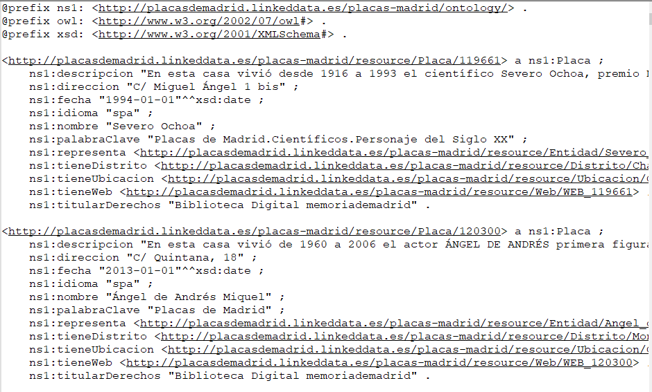
RDF GENERATION (II)
RML File
RDF File
Commemorative Plaques of Madrid
Notes:
RDF file in the Turtle syntax with the data transformed into RDF

Slide 8
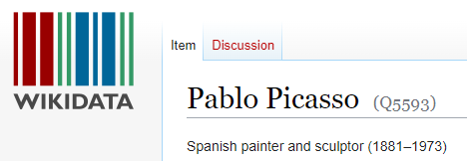
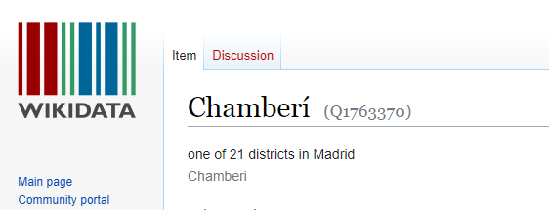
Link Data
Data linking
1. Identify the classes whose instances can be linked:
Wikidata Url in Openrefine → https://wikidata.reconci.link/en/api.
District → Wikidata - district of Madrid Q3032114
Entity → Wikidata - human Q5
2. Reconcile data with the identified datasets.
https://www.wikidata.org/wiki/Q5593
https://www.wikidata.org/wiki/Q1763370
Commemorative Plaques of Madrid
Notes:
The objective of this session is to learn about the RML mappings language and those relevant tools required to process semi-structured data, such as CSVs, JSON files, etc., in order to convert them into RDF.

Slide 9

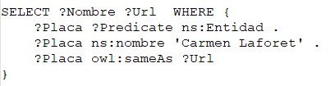
Link Data (II)
Export to RDF
Update the mappings and export the data to RDF.
s: http://placasdemadrid.linkeddata.es/placas-madrid/resource/Distrito/$(distritoID)
- [owl:sameAs,$(wikidata_distrito_uri)]
s: http://placasdemadrid.linkeddata.es/placas-madrid/resource/Entidad/$(entidadID)
- [owl:sameAs,$(wikidata_nombre_uri)]
Write some SPARQL queries to check the data.
RDF File
Commemorative Plaques of Madrid
Notes:
The objective of this session is to learn about the RML mappings language and those relevant tools required to process semi-structured data, such as CSVs, JSON files, etc., in order to convert them into RDF.

Slide 10

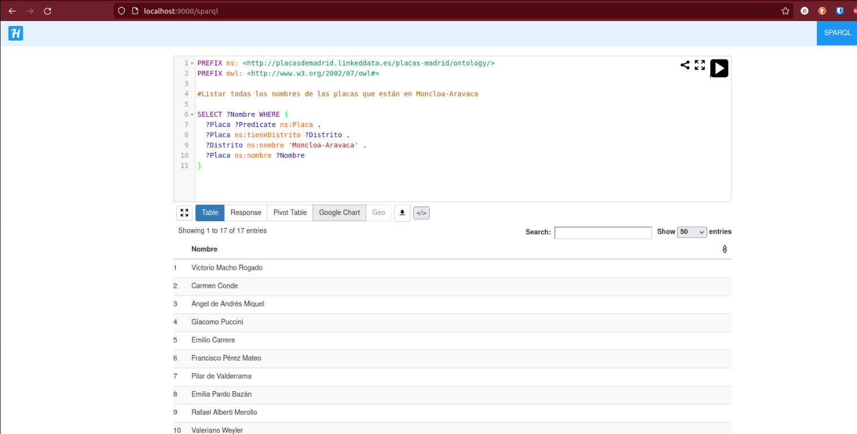
Linked data publishing
Publish OUR linked data with Helio.
Execute some SPARQL queries.

Slide 11
CHALLENGES WE HAVE FACED
Finding an existing ontology that matched our dataset.
Possible ontologies that could be used
http://vocab.linkeddata.es/datosabiertos/def/turismo/lugar/index-en.html --> Ontology for the representation of data on places of tourist interest, trips, routes, etc., in Spain.
http://vocab.linkeddata.es/datosabiertos/def/urbanismo-infraestructuras/callejero/index-en.html --> Ontology for the description of the street infrastructures of a municipality in Spain: roads, sections of roads and doorways
https://zaragoza.es/sede/portal/datos-abiertos/vocabularios/cruzar → Cruzar ontology for the generation of routes based on tourist profiles.
Establishing unique IDs for each entity of the classes
When linking data, some entities were not reconciled.

Slide 12
THANK YOU

